Slide 1


Andreas
2024-07-17

Slide 2

Outline
Executive Summary
Introduction
Methodology
Results
Conclusion
Appendix

Slide 3
Executive Summary
Summary of methodologies:
Data Collection using SpaceX API and web scraping
Exploratory Data Analysis (EDA), including data wrangling, data visualization and interactive visual analytics
Machine Learning Prediction
Summary of all results
We were able to collected valuable data from public sources
EDA used to identify which features are the best to predict success of launchings
Machine Learning Prediction showed the best model to predict

Slide 4
Introduction
Project background and context
Problems you want to find answers

Slide 5

Section 1

Slide 6
Methodology
Executive Summary
Data collection methodology:
Space X API (https://api.spacexdata.com/v4/rockets/)
WebScraping (https://en.wikipedia.org/wiki/List_of_Falcon/_9/_and_Falcon_Heavy_launches)
Perform data wrangling
Collected data was enriched by creating a landing outcome label based on outcome data after summarizing and analyzing features
Perform exploratory data analysis (EDA) using visualization and SQL
Perform interactive visual analytics using Folium and Plotly Dash
Perform predictive analysis using classification models
How to build, tune, evaluate classification models

Slide 7
Data Collection
Data was collected using SpaceX API by a get request to the SpaceX API (https://api.spacexdata.com/v4/rockets/). This was done by defining a helper functions that would help in the use of the API to extract data using identification numbers in the launch data and then requesting rocket launch data from the SpaceX API url.
Then to make the requested JSON results more consistent, the SpaceX launch data was requested and parsed using the GET request and then decoded the response content as a Json result which was then converted into a Pandas data frame.
We used BeautifulSoup and request Libraries we also get data from web scraping to collect Falcon 9 historical launch records from a Wikipedia page (https://en.wikipedia.org/wiki/List_of_Falcon/_9/_and_Falcon_Heavy_launches). The data was Parsed the table and converted it into a Pandas data frame

Slide 8
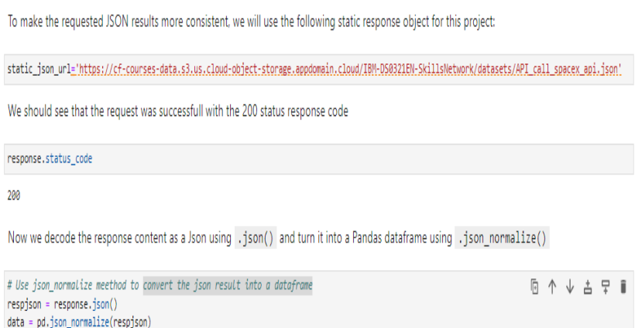
Data Collection – SpaceX API
Present your data collection with SpaceX REST calls using key phrases and flowcharts
https://github.com/mjae79/applied-data-science-capstone/tree/main/Lab%201
Place your flowchart of SpaceX API calls here

Slide 9
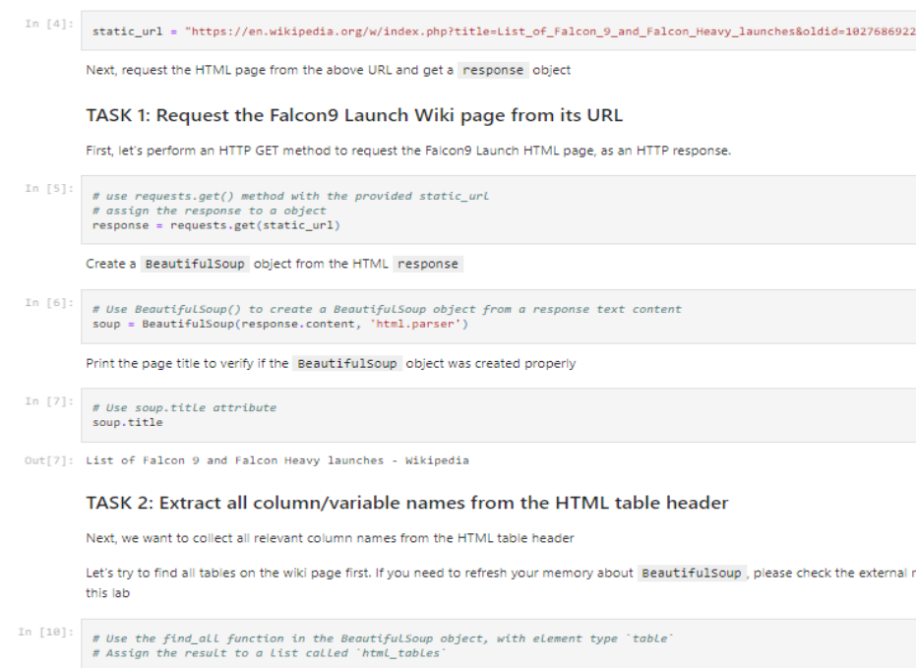
Data Collection - Scraping
Present your web scraping process using key phrases and flowcharts
https://github.com/mjae79/applied-data-science-capstone/tree/main/Lab%202
Place your flowchart of web scraping here

Slide 10
Data Wrangling
Creating a Pandas DF from the collected data, data was filtered using the BoosterVersion column to only keep the Falcon 9 launches, then dealt with the missing data values in the LandingPad and PayloadMass columns. For the PayloadMass , missing data values were replaced using mean value of column.
Exploratory Data Analysis (EDA) to find some patterns in the data and determine what would be the label for training supervised models
https://github.com/mjae79/applied-data-science-capstone/tree/main/Lab%203

Slide 11
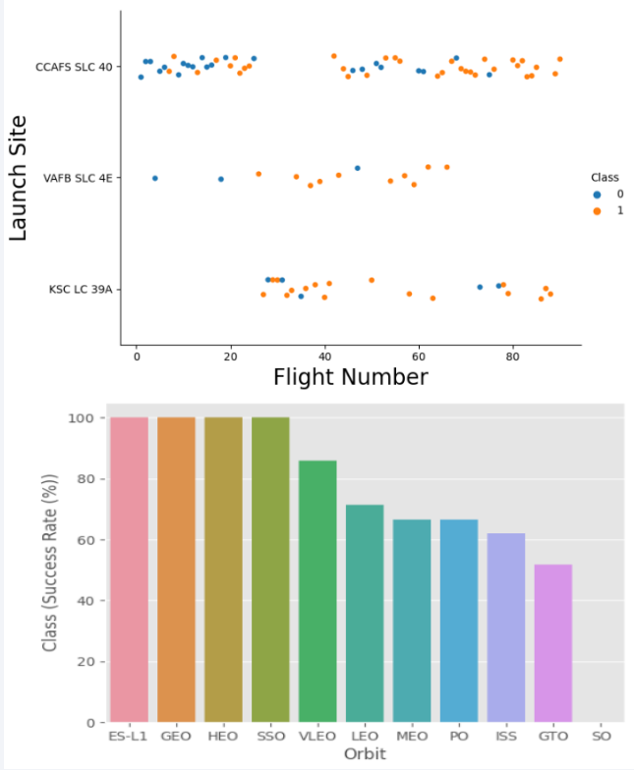
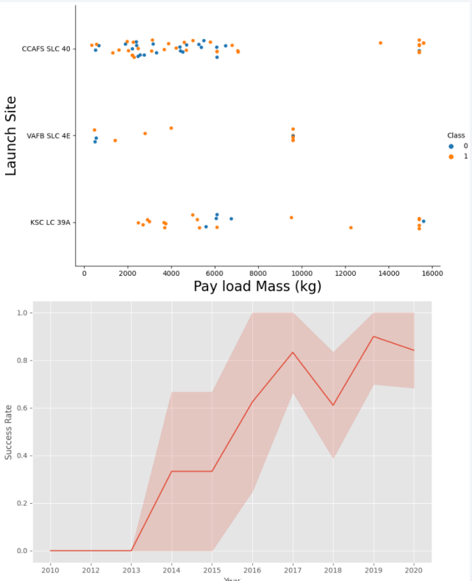
EDA with Data Visualization

Slide 12
EDA with SQL
Found out the unique names of the launch sites
Top 5 launch sites whose name begin with the string 'CCA’
Total payload mass carried by boosters launched by NASA (CRS)
Average payload mass carried by booster version F9 v1.1
Date when the first successful landing outcome in ground pad was achieved
https://github.com/mjae79/applied-data-science-capstone/blob/main/Lab%204/jupyter-labs-eda-sql-coursera_sqllite.ipynb

Slide 13
Build an Interactive Map with Folium
Markers indicate points like launch sites
Circles indicate highlighted areas around specific coordinates, like NASA Johnson Space Center
Marker clusters indicates groups of events in each coordinate, like launches in a launch site
Lines are used to indicate distances between two coordinates.
https://github.com/mjae79/applied-data-science-capstone/blob/main/Lab%207/spacex_dash_app.py

Slide 14
Build a Dashboard with Plotly Dash
Summarize what plots/graphs and interactions you have added to a dashboard
Explain why you added those plots and interactions
https://github.com/mjae79/applied-data-science-capstone/blob/main/Lab%207/spacex_dash_app.py

Slide 15
Predictive Analysis (Classification)
Summarize how you built, evaluated, improved, and found the best performing classification model
You need present your model development process using key phrases and flowchart
https://github.com/mjae79/applied-data-science-capstone/blob/main/Lab%208/SpaceX_Machine%20Learning%20Prediction_Part_5.ipynb

Slide 16
Results
Exploratory data analysis results
Interactive analytics demo in screenshots
Predictive analysis results

Slide 17

Section 2

Slide 18
Flight Number vs. Launch Site
Show a scatter plot of Flight Number vs. Launch Site
Show the screenshot of the scatter plot with explanations

Slide 19
Payload vs. Launch Site
Show a scatter plot of Payload vs. Launch Site
Show the screenshot of the scatter plot with explanations

Slide 20
Success Rate vs. Orbit Type
Show a bar chart for the success rate of each orbit type
Show the screenshot of the scatter plot with explanations

Slide 21
Flight Number vs. Orbit Type
Show a scatter point of Flight number vs. Orbit type
Show the screenshot of the scatter plot with explanations

Slide 22
Payload vs. Orbit Type
Show a scatter point of payload vs. orbit type
Show the screenshot of the scatter plot with explanations

Slide 23
Launch Success Yearly Trend
Show a line chart of yearly average success rate
Show the screenshot of the scatter plot with explanations

Slide 24
All Launch Site Names
Find the names of the unique launch sites
Present your query result with a short explanation here

Slide 25
Launch Site Names Begin with 'CCA'
Find 5 records where launch sites begin with `CCA`
Present your query result with a short explanation here

Slide 26
Total Payload Mass
Calculate the total payload carried by boosters from NASA
Present your query result with a short explanation here

Slide 27
Average Payload Mass by F9 v1.1
Calculate the average payload mass carried by booster version F9 v1.1
Present your query result with a short explanation here

Slide 28
First Successful Ground Landing Date
Find the dates of the first successful landing outcome on ground pad
Present your query result with a short explanation here

Slide 29
Successful Drone Ship Landing with Payload between 4000 and 6000
List the names of boosters which have successfully landed on drone ship and had payload mass greater than 4000 but less than 6000
Present your query result with a short explanation here

Slide 30
Total Number of Successful and Failure Mission Outcomes
Calculate the total number of successful and failure mission outcomes
Present your query result with a short explanation here

Slide 31
Boosters Carried Maximum Payload
List the names of the booster which have carried the maximum payload mass
Present your query result with a short explanation here

Slide 32
2015 Launch Records
List the failed landing_outcomes in drone ship, their booster versions, and launch site names for in year 2015
Present your query result with a short explanation here

Slide 33
Rank Landing Outcomes Between 2010-06-04 and 2017-03-20
Rank the count of landing outcomes (such as Failure (drone ship) or Success (ground pad)) between the date 2010-06-04 and 2017-03-20, in descending order
Present your query result with a short explanation here

Slide 34

Section 3

Slide 35
<Folium Map Screenshot 1>
Replace <Folium map screenshot 1> title with an appropriate title
Explore the generated folium map and make a proper screenshot to include all launch sites’ location markers on a global map
Explain the important elements and findings on the screenshot

Slide 36
<Folium Map Screenshot 2>
Replace <Folium map screenshot 2> title with an appropriate title
Explore the folium map and make a proper screenshot to show the color-labeled launch outcomes on the map
Explain the important elements and findings on the screenshot

Slide 37
<Folium Map Screenshot 3>
Replace <Folium map screenshot 3> title with an appropriate title
Explore the generated folium map and show the screenshot of a selected launch site to its proximities such as railway, highway, coastline, with distance calculated and displayed
Explain the important elements and findings on the screenshot

Slide 38

Section 4

Slide 39
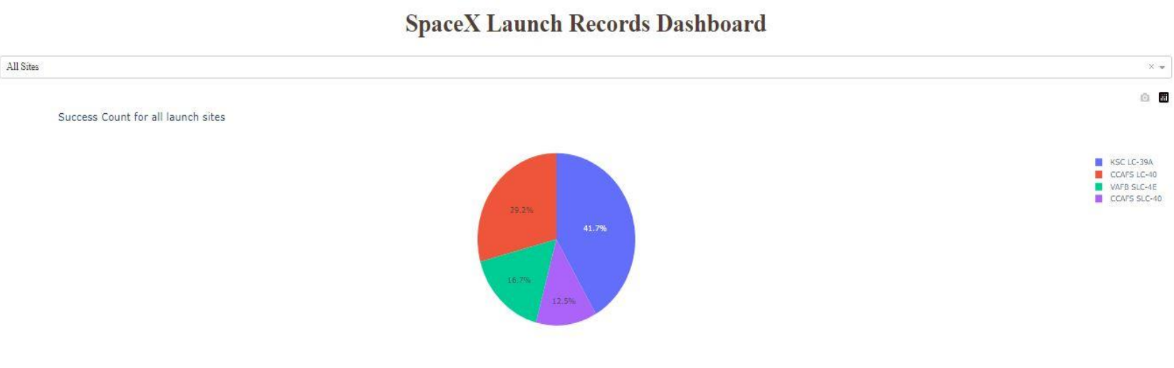
<Dashboard Screenshot 1>
Replace <Dashboard screenshot 1> title with an appropriate title
Show the screenshot of launch success count for all sites, in a piechart
Explain the important elements and findings on the screenshot
Launch site KSC LC-39A has the highest launch success rate at 42% followed by CCAFS LC-40 at 29%, VAFB SLC-4E at 17% and lastly launch site CCAFS SLC-40 with a success rate of 13%

Slide 40
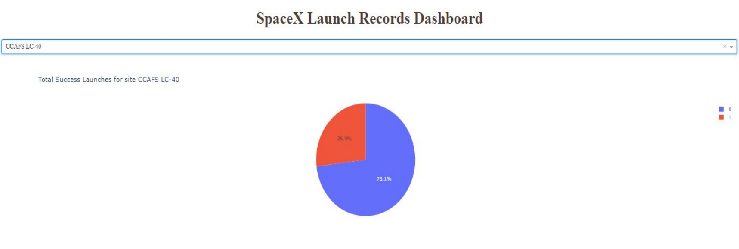
<Dashboard Screenshot 2>
Replace <Dashboard screenshot 2> title with an appropriate title
Show the screenshot of the piechart for the launch site with highest launch success ratio
Explain the important elements and findings on the screenshot
Launch site CCAFS LC-40 had the 2nd highest success ratio of 73% success against 27% failed launches

Slide 41
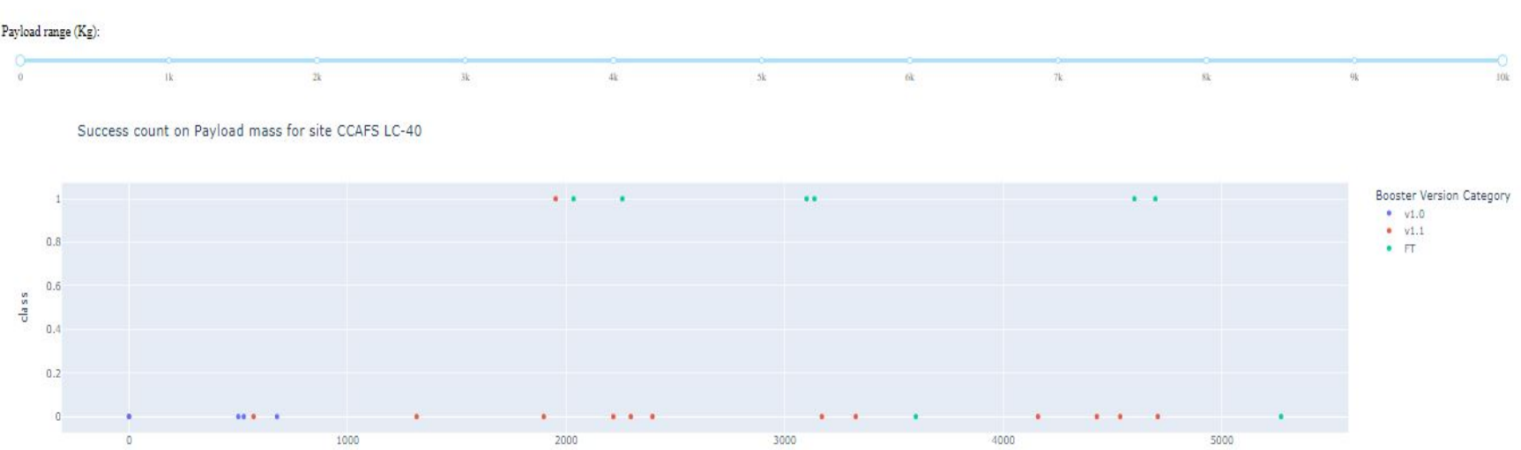
<Dashboard Screenshot 3>
Replace <Dashboard screenshot 3> title with an appropriate title
Show screenshots of Payload vs. Launch Outcome scatter plot for all sites, with different payload selected in the range slider
Explain the important elements and findings on the screenshot, such as which payload range or booster version have the largest success rate, etc.
For Launch site CCAFS LC-40 the booster version FT has the largest success rate from a payload mass of >2000kg

Slide 42

Section 5

Slide 43
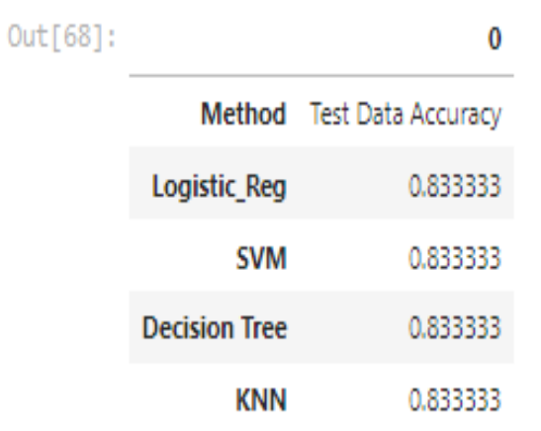
Classification Accuracy

Slide 44
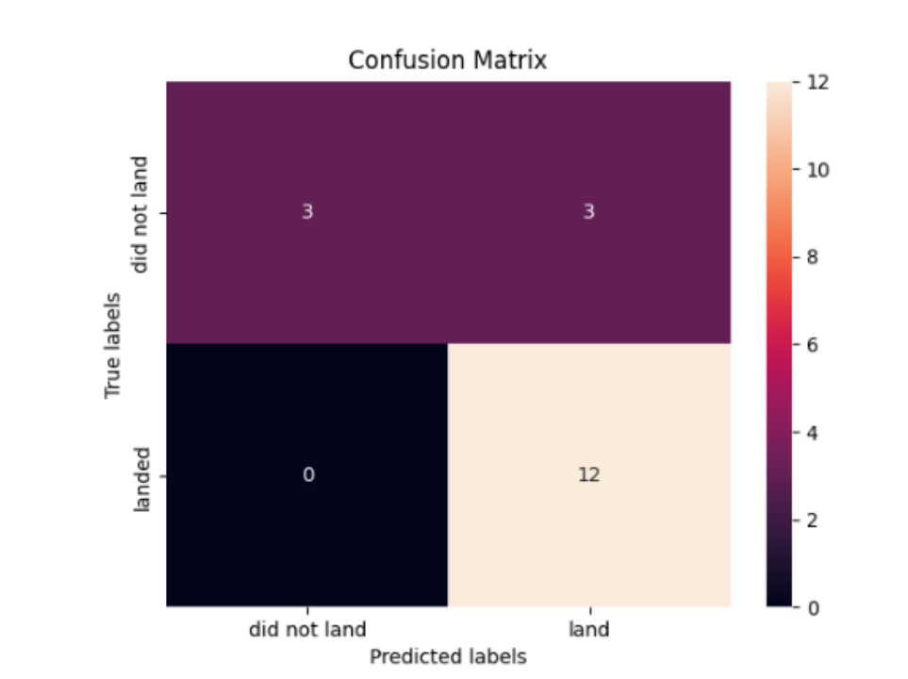
Confusion Matrix

Slide 45
Conclusions
Different launch sites have different success rates. CCAFS LC-40, has a success rate of 60 %, while KSC LC-39A and VAFB SLC 4E has a success rate of 77%.
We can deduce that, as the flight number increases in each of the 3 launcg sites, so does the success rate. For instance, the success rate for the VAFB SLC 4E launch site is 100% after the Flight number 50. Both KSC LC 39A and CCAFS SLC 40 have a 100% success rates after 80th flight
If you observe Payload Vs. Launch Site scatter point chart you will find for the VAFB-SLC launchsite there are no rockets launched for heavypayload mass(greater than 10000).
Orbits ES-L1, GEO, HEO & SSO have the highest success rates at 100%, with SO orbit having the lowest success rate at ~50%. Orbit SO has 0% success rate.
LEO orbit the Success appears related to the number of flights; on the other hand, there seems to be no relationship between flight number when in GTO orbit

Slide 46
Appendix
Include any relevant assets like Python code snippets, SQL queries, charts, Notebook outputs, or data sets that you may have created during this project

Slide 47


